Slide 1
BASIC ENGLISH STRUCTURES
i. The Active and Passive Voice
Basing on voice, a sentence can be either active or passive
Active voice refers to the sentences where the “doer” of the action is the subject and the “receiver” is the object
In passive voice, the receiver (object) becomes the doer (subject) and the doer (subject) becomes the receiver (object) formed by “by phrase” which is optional material
The passive is formed by using the verb to be followed by the main verb in past participle
Verb to be: be, being, been, is, was, are, were, am

Slide 2
….cont.
Examples:
Active: The bandits destroyed the houses
Passive: The houses were destroyed (by the bandits)
Active: The engineers will build a modern bungalow next year
Passive: The modern bungalow will be built next year (by engineers)
Active: Students must obey University by-laws
Passive: The University by-laws must be obeyed (by students)
Active: Computer scientists are testing new applications
Passive: New applications are being tested (by computer scientists)

Slide 3
….cont.
Uses of the Passive.
When the doer of the action is unknown or we don’t want to mention the doer
Active: The rebels killed his father
Passive: His father was killed
Active: Mkuki na Nyota printed that book.
Passive: That book was printed
(b) Used in scientific reports/experiments where is unnecessary to mention the doer
Sulphuric acid was added then the mixture was heated for 5 minutes…..
The prototype car was designed at MUST
(c) When we wish to draw attention to the subject rather than the agent
President Kennedy was killed by the bandit
His sister was knocked down by a coach

Slide 4
ii. Direct and Indirect (reported) Speeches
Direct speech refers to actual words of the original speaker WHILE
Indirect speech refers to utterances that are not quotations, but, reflect what somebody else said sometimes in the past
Indirect speech is when you report somebody else’s statement in your own words without any change in the meaning of the statement
When changing from direct to reported speeches there are some rules to pay attention to:
(a) Tense changes
Simple present becomes simple past
“I study structural mechanics every Monday,” he said.
He said (that) he studied structural mechanics every Monday.

Slide 5
….cont.
Present continuous becomes past continuous
“I am studying structural mechanics at the moment,” he said.
He said, he was studying structural mechanics at that moment.
Present perfect becomes past perfect
“I have studied structural mechanics for three years,” he said.
He said, he had studied structural mechanics for three years.
Present perfect continuous becomes past perfect continuous
“I have been studying structural mechanics for three years,” he said.
He said, he had been studying structural mechanics for three years.

Slide 6
….cont.
Simple past usually remains simple past
“I studied structural mechanics last year,” he said.
He said, he studied structural mechanics the previous year.
Future becomes conditional
“I will study structural mechanics next year,” he said.
He said, he would study structural mechanics the year before.
Future perfect becomes conditional perfect
“ I will have studied structural mechanics for three years next month,” he said.
He said, he would have studied structural mechanics for three years the month before.

Slide 7
(b) Pronoun and possessive adjective changes
“I have left my book in your car,” Mary told her boyfriend.
Mary told her boyfriend (that) she had left her book in his car.
(c) Demonstrative adjective changes
“I borrowed this pen from my cousin,” Eliakim said.
Eliakim said that he borrowed that pen from his cousin.
Direct Indirect
This That or the
These Those or the

Slide 8
iv. Adverb changes
“I will bring the photo tomorrow,” he said.
He said, he would bring the photo the next day.
Direct Indirect
Today That day
Yesterday The day before/the previous day
Tomorrow The next day/the following day
Last night The night before/the previous night
Here There
Ago Before
Now Then

Slide 9
v. Commands
“Take the books to the office,” the boss ordered the secretary.
The boss ordered the secretary to take the books to the office.
vi. Questions
“ Why have you locked the door?” the teacher asked me.
The teacher asked me why I had locked the door.
“Have you been to London before?” my father asked him.
My father asked him if he had been to London before.
“Have you ever watched terminator iii movie?”Joakina asked Ali politely.
Joakina asked Ali politely if he had ever watched terminator iii movie.

Slide 10
….cont.
General rules
a) A question changes to a statement
b) The question mark is dropped
c) Questions not beginning with interrogative words like why, who, when and what, require the addition of if or whether.

Slide 11
vii. Reporting Universal Facts
When reporting permanent states, facts, habits or universal truth, there will be no change of tenses.
Here the logic is what was said is still true when it is reported
Thus, in this case we keep the tense of the original speech
Examples
“The world rotates around the sun”, that geographer said.
That geographer said that the world rotates around the sun.
ii) “ The earth has spherical shape”, the teacher said.
The teacher said that the earth has spherical shape.

Slide 12
…Cont.
iii) “Water freezes at zero degree of centigrade”, the scientist said.
The scientist said said that water freezes at zero degree of centigrade.
iv) “ Magnet attracts iron”, the student told the class.
The student told the class that magnet attracts iron.
v) “The sun rises from east and set to west”, the professor reported.
The professor reported that the sun rises from east and set to west

Slide 13
iii. Conditional Sentences
These are sentences that express a condition to be fulfilled first before something else happens
eg. If the rain stops, we will be able to finish the work.
I will tell her the truth if we meet in canteen.
Basically, there are three types of conditional sentences:
The three types require different tense sequences and have different meanings.
Conditional type 1
This is called likely or open condition because there is a great possibility that something will happen if the condition is fulfilled
It uses simple present tense in the dependent clause and future time in the main clause

Slide 14
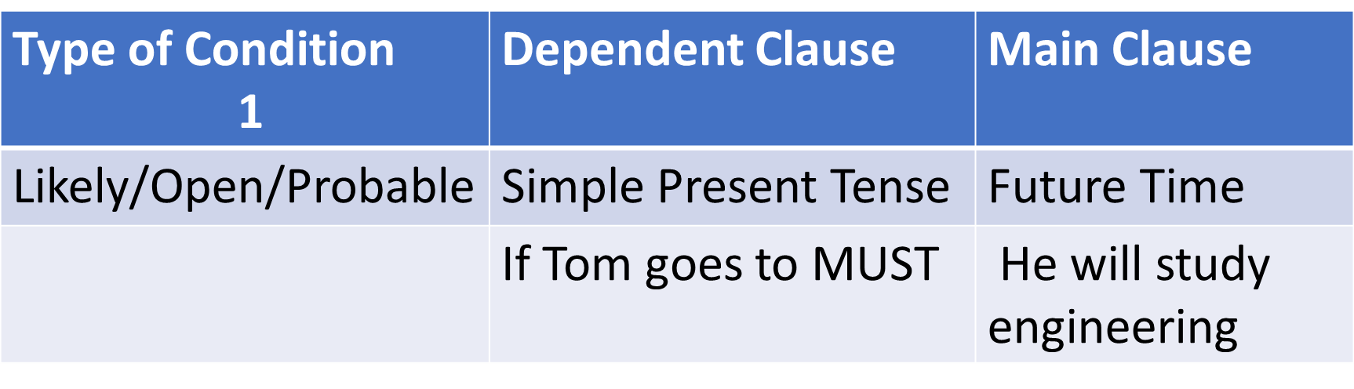

Slide 15
….Cont.
If Tom goes to MUST, he will study engineering.
This implies that it is possible that Tom will join MUST and study engineering
More examples
If you step on a snake it will bite you
People will starve if it does not rain for two years
Yunis will go home if she finishes the work
Sometimes “Unless” is used to mean “If not”
Unless you work hard, you will not pass this module
You will not go to heaven unless you repent the sins

Slide 16
(b) Conditional Type 2
This is called unlikely/closed condition because it is unlikely that the condition will be fulfilled
It uses simple past tense in the dependent clause and conditional tense in the main clause

Slide 17
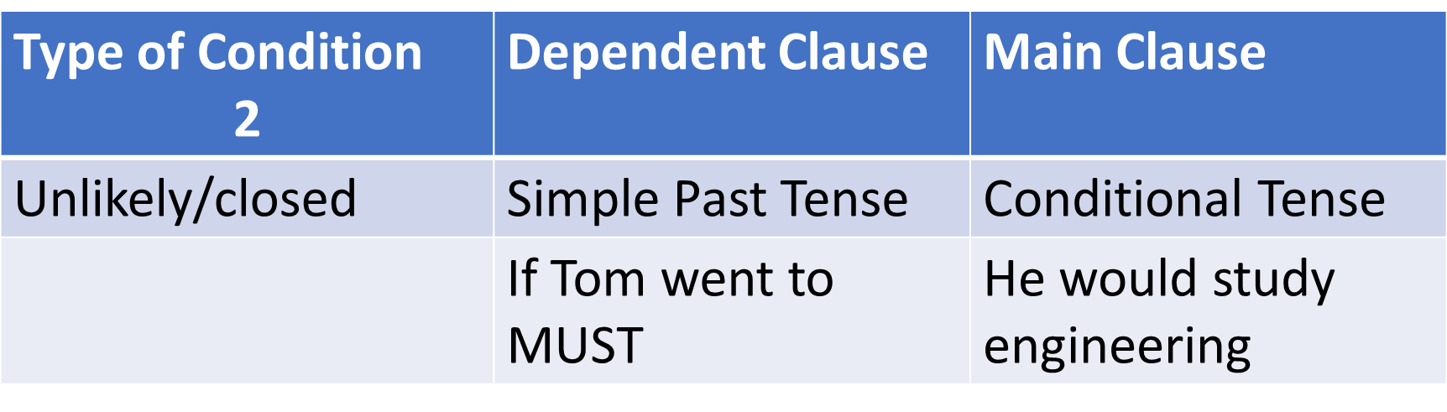

Slide 18
….Cont.
If Tom went to MUST, he would study engineering.
This implies that Tom is unlikely to go to MUST to study engineering
More examples
If a thief broke into my house, I would call the police
If it rained much in Dodoma, they would plant rice
You could be selected if you passed your examinations
If I had enough money I would buy a new model of V8

Slide 19
(c) Conditional Type 3
This is purely hypothetical conditional because everything is in the past which implies that nothing can be changed at the moment
Is formed by dependent clause in past perfect and main clause in past conditional

Slide 20
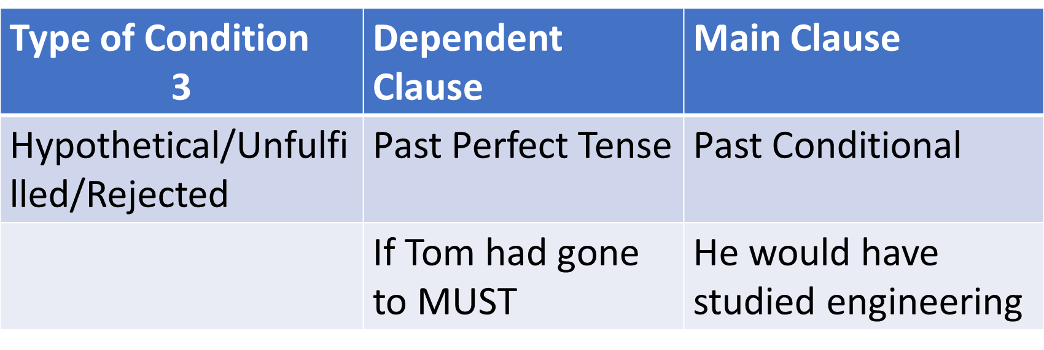

Slide 21
….Cont.
If Tom had gone to MUST, he would have studied engineering
The sentence implies that Tom did not go to MUST therefore did not study engineering
More examples
If I had been in Argentine, I would have witnessed Diego’s burial ceremony
If we had hired a car, we could have saved some money
If his brother had been driving, the accident would not have happened
The architect would have designed a more expensive house if the owner had agreed to pay.

Slide 22
iv. Question Tags
In conversation, we sometimes ask a question not because we need information but confirmation of what we already know
We want the person addressed to agree with us and keep the conversation going
To achieve this, we add a tag question to a statement.
A question tag is therefore, a short question that follows a statement
It is made up of an auxiliary plus personal pronoun
eg. You don’t like history, do you?
That saloon belongs to mama Kimbo, doesn’t it?
Tabuley Roucherou had 104 children,……..?

Slide 23
Some Guiding Rules:
There should be a comma before a question tag and a question mark after the tag
If the statement is affirmative (positive) the tag question should be negative
You are the prospective engineer, aren’t you?
(c) If the statement is negative, the question tag should be positive
You will not read that book, will you?
(d) If you are asking a question tag in which you want “YES” answer, a question tag should be negative
She likes mathematics, doesn’t she?
Answer: YES, she does

Slide 24
….Cont.
(e) If you expect the answer “NO” the question tag becomes positive
You are not my enemy, are you?
Answer: NO, I am not
(f) The tense of the tag should correspond to the tense of the statement.
They did not greet their teacher, did they?
We are lost, aren’t we?
(g) Need, dare and am when used positively in a statement are not repeated in the tag
We need a rest, don’t we?

Slide 25
….Cont.
I am your enemy, aren’t I?
He dared to stroke the lion, didn’t he?
(h) A command can be made into less of a command and more of a request by the addition of a positive tag in the future tense:
Pass me the sugar, will you?
Open the window, will you?
(I) Since question tags are used almost solely in conversation, the shortened form of the negative (don’t, won’t, doesn’t etc.) is used and pronounced as one word.

